Slide 1


Green Pace
Security Policy Presentation
Developer: Andreas Galatis
Notes:
Good morning my name is Andreas Galatis, and the following presentation is for the implementation of the Green Pace security policy

Slide 2

OVERVIEW: DEFENSE IN DEPTH
Notes:
In March of 2019, the personal information of more than 106 million Capital One customers had been compromised because of script commands that were maliciously deployed by a hacker working for the company that hosted the cloud computing servers Capital One was operating on (Conger, 2022).
The attack was made possible due to a failure in the Web Application Firewall, and the lack of another layer of security to guard against it.
This is why the security strategy of Defense in Depth is so vital. It uses several layers of redundant defenses to guard against a variety of threats and attacks. If one layer fails the next layer can prevent the potential of another threat.

Slide 3
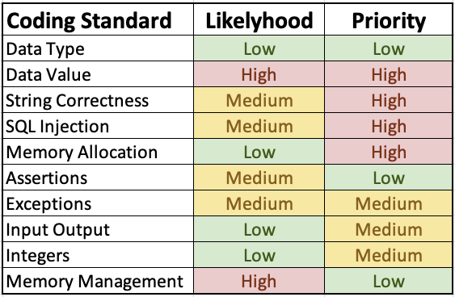
THREATS MATRIX
Notes:
The following threat matrix displays the 10 coding standards that are listed in the security policy with two columns that determine their likelihood of occurrence and their priority level, ranked low, medium, or high. These ten standards are some of the more common threat areas exploited by attackers, as well as common errors that developers make when writing code.

Slide 4
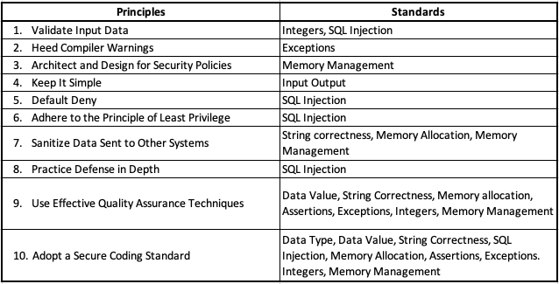
10 PRINCIPLES
Notes:
All of the coding standards are connected to the 10 security principles as listed here. The most effective principle to adhere to is to adopt a secure coding standard for best practices always begin with the developer. This can impact almost all of the coding standards, especially those related to data type, data value, string correctness and SQL injection. Since the most common coding standard is to prevent SQL injection, it relates to several principles of default deny, adhering to the principle of least privilege, and practicing defense in depth.

Slide 5
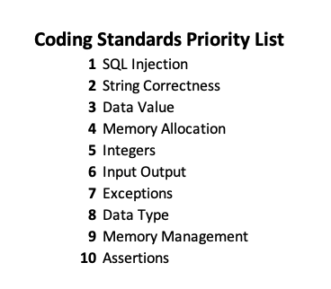
CODING STANDARDS
Notes:
That is why SQL injection is listed as the number one priority on the coding standards list, followed by string correctness and data value, as these three can be closely connected. The remaining priority as memory allocation, integers, input output, exceptions, data type, memory management, and assertions

Slide 6
TRIPLE-A POLICIES
> Authentication
Provides the means for which a system user can identify themselves by entering a valid username and password.
> Authorization
Limit privileged to access private and sensitive data to allowed personnel .
> Accounting
Monitor all resources that have access, ensuring they are not in there for more time than they need to be
Notes:
When It comes to defense in depth, the Triple-A policies of authentication, authorization, and accounting are very important. These are the benchmarks of a good security policy implementation. Authentication provides the means for which a system user can identify themselves by entering a valid username and password. By each user having their own set of access credentials, it will ensure that hackers or unintended users will not access sensitive information. Authorization has to do with organizations having effective policies that determine who is allowed to access private and sensitive data and who is not. And accounting has to do with monitoring all the resources that all the users access, and ensuring that they are not in there for more time than they need to be.

Slide 7
ENCRYPTION POLICIES
> Encryption in rest
Enables data that is stored or at rest, to be protected.
> Encryption at flight
Encryption of data that is moving over a network, such as in a cloud server.
> Encryption in use
Ensures that sensitive data is never left unsecured, regardless if it is at rest, in transit, or in use, or what source it’s from, or its location, such as on site, cloud, or hybrid.
Notes:
In addition to the Triple-A defense, there are several types of encryptions that need to be implemented. Encryption at rest is enables data that is stored or at rest, to be protected. It is vital to protect such data since it may be a target for a physical type of attack on the hardware. Encryption at flight encryption is for data that is moving over a network, such as in a cloud server. A multilevel approach is recommended for such data by using end-to-end encryption with client-side and server-side certificates and encryption keys. And lastly, Encryption in use covers all data, whether the data regardless of whether it is at rest or in flight.

Slide 8
Unit Testing
Test 1: Assertions
Non-Compliant
public static int getAbsAdd(int x, int y) {
assert x != Integer.MIN_VALUE;
assert y != Integer.MIN_VALUE;
int absX = Math.abs(x);
int absY = Math.abs(y);
assert (absX <= Integer.MAX_VALUE - absY);
return absX + absY;
}
Compliant
public static int getAbsAdd(int x, int y) {
if (x == Integer.MIN_VALUE || y == Integer.MIN_VALUE) {
throw new IllegalArgumentException();
}
int absX = Math.abs(x);
int absY = Math.abs(y);
if (absX > Integer.MAX_VALUE - absY) {
throw new IllegalArgumentException();
}
return absX + absY;
}
Notes:
Test 1: Assertions cannot be used to validate arguments inside a method. Here in the non-compliant code if the value of variable x or y is the minimum allowable value, then the code will not stop the execution, because assertions do not operate as exceptions. In the compliant code, an illegal argument exception argument is placed in the code to ensure that any value that is the minimum allowed amount will not execute.

Slide 9
Unit Testing
Test 2: Integer Overflow
Non-Compliant
void func(signed int a, signed int b) {
signed int sum = a + b;
/* ... */
}
Compliant
#include <limits.h>
void f(signed int a, signed int b) {
signed int sum;
if (((b > 0) && (a > (INT_MAX - b))) ||
((b < 0) && (a < (INT_MIN - b)))) {
/* Handle error */
} else {
sum = a + b;
}
/* ... */
}
Notes:
Test 2: Integer Overflow. In the non-compliant code, there are no parameters that prevent the sum of variable a and b to result in an integer overflow. For example, in the user enters a number for one of the variables that is greater than a number that an integer type can take, then it will cause the sum calculation to output an incorrect number due to the overflow. The correct way to do it is to add conditional statements as shown in the compliant example to ensure that the user doesn’t exceed the limits

Slide 10
Unit Testing
Test 3: Exceptions
Non-Compliant
void throwing_func() noexcept(false);
void f() {
throwing_func();
}
int main() {
f();
}
Compliant
void throwing_func() noexcept(false);008
void f() {
throwing_func();
}
int main() {
try {
f();
} catch (...) {
// Handle error
}
}
Notes:
Test 3: Exceptions. In the non-compliant example neither the function f() nor the main() function have a catch statement even though there is a throwing_func() function there. In this case if the code encounters a situation that it is supposed to catch it will miss it because there is no catch statement. The correct way to do it is by adding a catch statement as shown in the compliant code example.

Slide 11
Unit Testing
Test 4: Input Output
Non-Compliant
void f(const std::string &fileName) {
std::fstream file(fileName);
if (!file.is_open()) {
// Handle error
return;
}
std::terminate();
}
Compliant
void f(const std::string &fileName) {
std::fstream file(fileName);
if (!file.is_open()) {
// Handle error
return;
}
file.close();
if (file.fail()) {
// Handle error
}
std::terminate();
Notes:
Test 4: Input Output. In the non-compliant code, a file is opened and used in the program, but it is not closed. What can happen is that if there is code in another segment of the program that accesses that file, it may overwrite or delete the file by mistake. The correct way to handle files in code is to always make sure to add a statement to close the file once the necessary execution has been completed in that segment of code block. In the compliant code example, the file is closed correctly with a conditional statement to make sure it was done right

Slide 12

AUTOMATION SUMMARY
Notes:
In the flow of automation, the security tools and principles are implemented from the beginning in pre-production. During the planning phase all possible threats are assessed, with proper responses planned out based on thorough analysis. Then in the design phase, test-driven design for security adopted from OWASP are integrated into the system. These designs are then built with secure coding and trusted repositories in the build phase. Before production, the system undergoes static and dynamic testing and vulnerability scanning. Once the application reaches production, security measures should continue by means of penetration testing to catch any vulnerabilities in a live environment as well as constant monitoring by means of log collection and intrusion detection. Proper responses should then be taken to block attacks, or turn off services in case of a breach. Lastly, the application should remain under constant maintenance to assess ongoing security threats and periodic security baseline updates to ensure a stable state.

Slide 13
TOOLS
Security Logging Tools
Logging tools can monitor access to resources so that administrators can track what is happening on the network.
Network Penetration Testing Tools
Penetration testing tools can scan hosts for open ports, outdated software versions/patches, missing patches/updates, etc. They are similar to vulnerability scanning tools but they focus on penetration or brute force attacks
Security Monitoring and Alerting Tool (SMAAT)
Monitors all the activities that happen across the network and will alert any anomalies or security incidents.
Notes:
Some automation tools that will be used in the security development pipeline include, security logging that will monitor access to any resources in order for administrators to track what is happening. Network Penetration Testing tools will be used to scan for open ports, as well as outdated software version. They focus mostly on brute force attacks. And Security monitoring and alert tools that will monitor all the activities that happen across the network to alert for any anomalies.

Slide 14
RISKS AND BENEFITS
Benefits:
Finding and fixing issues early in development to avoid costly breaches, vulnerabilities, and compliance violations down the line
Taking an integrated approach to life cycle security by streamlining processes between teams to avoid friction and reduce risks
Risks:
Effects on overall system security
Effects on productivity
Notes:
The benefits of implementing defense in depth and integrating it into the development process include finding and fixing issues early to avoid costly breaches and vulnerabilities. Also, this method takes an integrated approach to the security lifecycle by streamlining the process throughout the development team. The risks involved with not doing so are overall security effects on the system by not catching vulnerabilities before they become major breaches and effects on productivity as the security teams will be forced to restrict access to the development teams when more vulnerabilities are left unchecked.

Slide 15
RECOMMENDATIONS
Email Security
Make sure to always check email addresses and names of senders
Remote Access
Even when working remotely, all security principles and standards need to be maintained
Transferring Data
Refrain from transferring classified information to employees and outside parties.
Notes:
Some additional security measures that should be considered for the organization are email security policies, remote access best practices, and caution when transferring data. While these may not be directly related to writing code, they also paly an integral part in making sure to protect the organization from external threats, as hackers often use these methods to infiltrate systems

Slide 16
CONCLUSIONS
Practice Defense in Depth
Carefully analyze the threat levels
Adhere to all coding standards and principles
Implement Triple-A policy and Encryption
DevSecOps - Test early and often
Use automation tools regularly
Notes:
In conclusion, this policy lays out the importance in applying a defense in depth strategy, while making sure to analyze all threat levels. The provided coding standards and principles have to be well integrated in the organization and all projects. The Triple-A policy and the encryption rules are to be the benchmarks of all systems without compromise. A DevSecOps framework of including security in the development process will enable the testing and integration of important security measures early and often. And lastly it is highly recommended that automation tools be used to combat threats, as these are not prone to human error.

Slide 17
REFERENCES
Conger, K. (2022, June 18). Ex-Amazon Worker Convicted in Capital One Hacking. The New York Times. Retrieved October 1, 2022, from https://www.nytimes.com/2022/06/17/technology/paige-thompson-capital-one-hack.html

